Slide 1
Adversarial Search & Game Playing

Slide 2
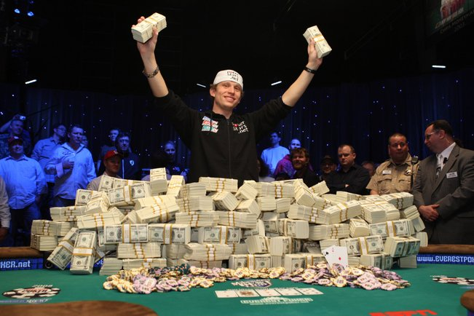

Slide 3
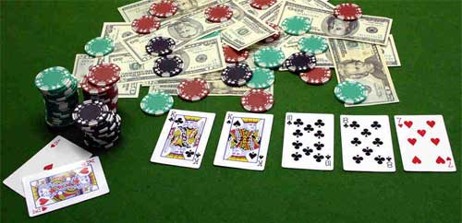
Texas Hold ‘Em Poker
2 cards per player, face down
5 community cards dealt incrementally
Winner has best 5-card poker hand
4 betting rounds:
0 cards dealt
3 cards dealt
4th card
5th card
Uncertainty about future cards dealt
Uncertainty about other players’ cards

Slide 4
The Real World and its Representation
3x3 matrix filled
with 1, 2, .., 8, and
‘empty’
Agent’s conceptualization (→ representation language)
Real world
8-puzzle

Slide 5
The Real World and its Representation
Geometric models and equations of motion
Agent’s conceptualization (→ representation language)
Real world
Robot navigating among moving obstacles

Slide 6
The Real World and its Representation
Seen cards
Chip counts
History of past bets
Agent’s conceptualization (→ representation language)
Real world
Actual cards
Emotions
Subconscious cues

Slide 7
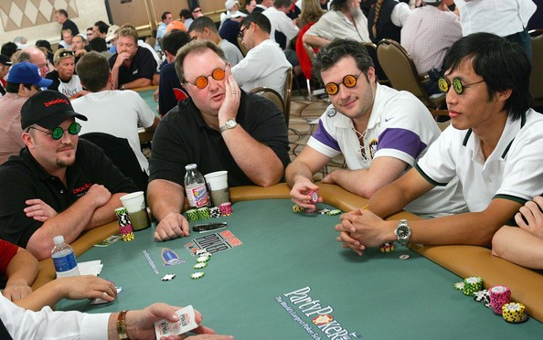

Slide 8
Who provides the representation language?
The agent’s designer
As of today, no practical techniques exist allowing an agent to autonomously abstract features of the real world into useful concepts and develop its own representation language using these concepts
The issues discussed in the following slides arise whether the representation language is provided by the agent’s designer or developed over time by the agent

Slide 9
First Source of Uncertainty: Imperfect Predictions
There are many more states of the real world than can be expressed in the representation language
So, any state represented in the language may correspond to many different states of the real world, which the agent can’t represent distinguishably
The language may lead to incorrect predictions about future states
On(A,B) ∧ On(B,Table) ∧ On(C,Table) ∧ Clear(A) ∧ Clear(C)
A
A
A
B
C
C
B
B
C

Slide 10
Nondeterministic Search in Game Playing
In game playing, an adversary can choose outcomes of the agent’s moves
Instead of a single path, the agent must construct plans for all possible outcomes
MAX’s play
MIN’s play
MAX must decide what to play for BOTH these outcomes

Slide 11
Game Playing
Games like Chess or Go are compact settings that mimic the uncertainty of interacting with the natural world
For centuries humans have used them to exert their intelligence
Recently, there has been great success in building game programs that challenge human supremacy

Slide 12
Specific Setting Two-player, turn-taking, deterministic, fully observable, zero-sum, time-constrained game
State space
Initial state
Successor function: it tells which actions can be executed in each state and gives the successor state for each action
MAX’s and MIN’s actions alternate, with MAX playing first in the initial state
Terminal test: it tells if a state is terminal and, if yes, if it’s a win or a loss for MAX, or a draw
All states are fully observable

Slide 13
Nondeterminism
Uncertainty is caused by the actions of another agent (MIN), who competes with our agent (MAX)
MIN wants MAX to lose (and vice versa)
No plan exists that guarantees MAX’s success regardless of which actions MIN executes (the same is true for MIN)
At each turn, the choice of which action to perform must be made within a specified time limit

Slide 14
Game Tree
MAX nodes
MAX’s play →
MIN nodes
MIN’s play →
Here, symmetries have been used to reduce the branching factor
Terminal state (win for MAX) →

Slide 15
Game Tree
MAX’s play →
MIN’s play →
In general, the branching factor and the depth of terminal states are large
Chess:
Number of states: ~10⁴⁰
Branching factor: ~35
Number of total moves in a game: ~100
Terminal state (win for MAX) →

Slide 16
Choosing an Action: Basic Idea
Using the current state as the initial state, build the game tree uniformly to the leaf nodes
Evaluate whether leaf nodes are wins (+1), losses (-1), or draws (0)
Back up the results from the leaves to the root and pick the best action assuming the worst from MIN
→ Minimax algorithm

Slide 17
Minimax Backup
MAX’s turn
MIN’s turn
+1
MAX’s turn
-1
0
+1
0

Slide 18
Minimax Backup
MAX’s turn
MIN’s turn
+1
0
+1
0
MAX’s turn
-1
0
+1
0

Slide 19
Minimax Backup
MAX’s turn
0
-1
MIN’s turn
+1
0
+1
0
MAX’s turn
-1
0
+1
0

Slide 20
Minimax Backup
+1
MAX’s turn
0
-1
MIN’s turn
+1
0
+1
0
MAX’s turn
-1
0
+1
0

Slide 21
Minimax Algorithm
Expand the game tree from the current state (where it is MAX’s turn to play)
Evaluate whether every leaf of the tree is a win (+1), lose (-1), or draw (0)
Back-up the values from the leaves to the root of the tree as follows:
A MAX node gets the maximum of the evaluation of its successors
A MIN node gets the minimum of the evaluation of its successors
Select the move toward a MIN node that has the largest backed-up value

Slide 22
Real-Time decisions
The state space is enormous: only a tiny fraction of this space can be explored within the time limit (3min for chess)
Using the current state as the initial state, build the game tree uniformly to the maximal depth h (called horizon) feasible within the time limit
Evaluate the states of the leaf nodes
Back up the results from the leaves to the root and pick the best action assuming the worst from MIN

Slide 23
Evaluation Function
Function e: state s → number e(s)
e(s) is a heuristic that estimates how favorable s is for MAX
e(s) > 0 means that s is favorable to MAX (the larger the better)
e(s) < 0 means that s is favorable to MIN
e(s) = 0 means that s is neutral

Slide 24
Example: Tic-tac-Toe
e(s) = number of rows, columns, and diagonals open for MAX
− number of rows, columns, and diagonals open for MIN
8−8 = 0
6−4 = 2
3−3 = 0

Slide 25
Construction of an Evaluation Function
Usually a weighted sum of “features”:
Features may include
Number of pieces of each type
Number of possible moves
Number of squares controlled

Slide 26
Backing up Values
Tic-Tac-Toe tree
at horizon = 2
1
Best move
-1
1
-2
6-5=1
5-5=0
6-5=1
5-5=1
4-5=-1
5-4=1
6-4=2
5-6=-1
5-5=0
5-6=-1
6-6=0
4-6=-2

Slide 27
Continuation
1
1
0
2
1
3
1
2
1
1
1
0
2
0
1
1
0
2
2
3
1
2
2
1
1
0

Slide 28
Why using backed-up values?
At each non-leaf node N, the backed-up value is the value of the best state that MAX can reach at depth h if MIN plays well (by the same criterion as MAX applies to itself)
If e is to be trusted in the first place, then the backed-up value is a better estimate of how favorable STATE(N) is than e(STATE(N))

Slide 29
Minimax Algorithm
Expand the game tree uniformly from the current state (where it is MAX’s turn to play) to depth h
Compute the evaluation function at every leaf of the tree
Back-up the values from the leaves to the root of the tree as follows:
A MAX node gets the maximum of the evaluation of its successors
A MIN node gets the minimum of the evaluation of its successors
Select the move toward a MIN node that has the largest backed-up value

Slide 30
Minimax Algorithm
Expand the game tree uniformly from the current state (where it is MAX’s turn to play) to depth h
Compute the evaluation function at every leaf of the tree
Back-up the values from the leaves to the root of the tree as follows:
A MAX node gets the maximum of the evaluation of its successors
A MIN node gets the minimum of the evaluation of its successors
Select the move toward a MIN node that has the largest backed-up value
Horizon: Needed to return a decision within allowed time

Slide 31
Game Playing (for MAX)
Repeat until a terminal state is reached
Select move using Minimax
Execute move
Observe MIN’s move
Note that at each cycle the large game tree built to horizon h is used to select only one move
All is repeated again at the next cycle (a sub-tree of depth h-2 can be re-used)

Slide 32
Properties of Minimax
Complete?
Optimal?
Time complexity?
Space complexity?

Slide 33
Properties of Minimax
Complete? Yes, if tree is finite
Optimal? Yes, against optimal opponent. Otherwise…?
Time complexity? O(b^{h})
Space complexity? O(bh)
For chess, b=35:
h | b^{h}
3 | 42875
5 | 5x10⁷
10 | 3x10¹⁵
15 | 1x10²³
Good
Master

Slide 34
Can we do better?
Yes ! Much better !
≥ 3
3
≤ -1
← Pruning
This part of the tree can’t have any effect on the value that will be backed up to the root
-1

Slide 35
State-of-the-Art

Slide 36
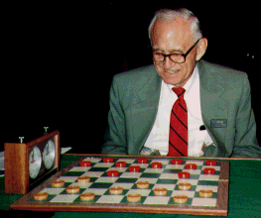
Checkers: Tinsley vs. Chinook
Name: Marion Tinsley
Profession: Teach mathematics
Hobby: Checkers
Record: Over 42 years loses only 3 games of checkers
World champion for over 40 years
Mr. Tinsley suffered his 4th and 5th losses against Chinook

Slide 37
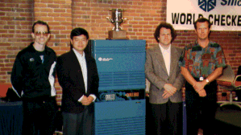
Chinook
First computer to become official world champion of Checkers!

Slide 38
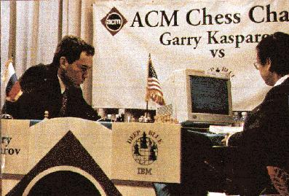
Chess: Kasparov vs. Deep Blue
Kasparov
5’10”
176 lbs
34 years
50 billion neurons
2 pos/sec
Extensive
Electrical/chemical
Enormous
Height
Weight
Age
Computers
Speed
Knowledge
Power Source
Ego
Deep Blue
6’ 5”
2,400 lbs
4 years
32 RISC processors + 256 VLSI chess engines
200,000,000 pos/sec
Primitive
Electrical
None
1997: Deep Blue wins by 3 wins, 1 loss, and 2 draws
Jonathan Schaeffer

Slide 39
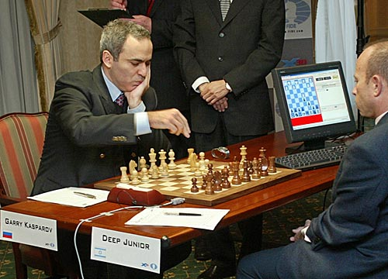
Chess: Kasparov vs. Deep Junior
Deep Junior
8 CPU, 8 GB RAM, Win 2000
2,000,000 pos/sec
Available at $100
August 2, 2003: Match ends in a 3/3 tie!

Slide 40
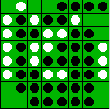
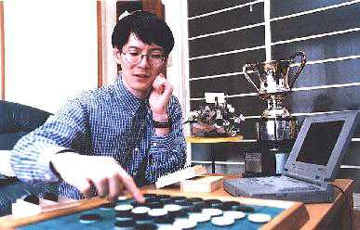
Othello: Murakami vs. Logistello
Takeshi Murakami
World Othello Champion
1997: The Logistello software crushed Murakami by 6 games to 0

Slide 41
Secrets
Many game programs are based on alpha-beta pruning + iterative deepening + extended/singular search + transposition tables + huge databases + ...
For instance, Chinook searched all checkers configurations with 8 pieces or less and created an endgame database of 444 billion board configurations
The methods are general, but their implementation is dramatically improved by many specifically tuned-up enhancements (e.g., the evaluation functions) like an F1 racing car

Slide 42
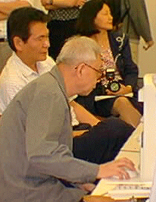
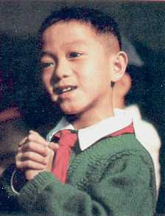
Go: Goemate vs. ??
Name: Chen Zhixing
Profession: Retired
Computer skills:
self-taught programmer
Author of Goemate, winner of 1994 Computer Go Competition
Gave Goemate a 9 stone
handicap and still easily
beat the program,
thereby winning $15,000
Jonathan Schaeffer

Slide 43
Go: Goemate vs. ??
Name: Chen Zhixing
Profession: Retired
Computer skills:
self-taught programmer
Author of Goemate (arguably the strongest Go programs)
Go has too high a branching factor for existing search techniques
Gave Goemate a 9 stone
handicap and still easily
beat the program,
thereby winning $15,000
Jonathan Schaeffer

Slide 44
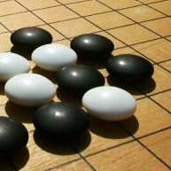
Recent Developments
Modern Go programs perform at high amateur level
Can beat pros, given a moderate handicap
Not actually a pattern recognition solution, as once previously thought: better search techniques

Slide 45
Perspective on Games: Con and Pro
Chess is the Drosophila of artificial intelligence. However, computer chess has developed much as genetics might have if the geneticists had concentrated their efforts starting in 1910 on breeding racing Drosophila. We would have some science, but mainly we would have very fast fruit flies.
John McCarthy
Saying Deep Blue doesn’t really think about chess is like saying an airplane doesn't really fly because it doesn't flap its wings.
Drew McDermott

Slide 46
Other Types of Games
Multi-player games, with alliances or not
Games with randomness in successor function (e.g., rolling a dice) → Expectminimax algorithm
Games with partially observable states (e.g., card games) → Search over belief states

Slide 47
Next Class
Alpha-beta pruning
Games of chance
Partial observability
R&N 5.5-5.6

Slide 48
Project Proposal (Optional)
Mandatory: instructor’s advance approval
Project title, team members
~1 page description
Specific topic (problem you are trying to solve, topic of survey, etc)
Why did you choose this topic?
Methods (researched in advance, sources of references)
Expected results
Email to me by 9/20

